Slide 1
Contents
Introduction
Types of mobile apps
Mobile app platforms
Android Platform Overview
Mobile application components
APK Structure and APK signing schemes
Sandboxing and permissions
Mobile Application Threat Model

Slide 2
Contents contd...
Deeplinks and webviews
Mobile App Tampering and Reverse Engineering
Mobile Application Security Testing
Static analysis of mobile application
Dynamic analysis of mobile application

Slide 3
Introduction
Mobile application security penetration testing is the practice of assessing and identifying vulnerabilities within mobile applications.
Mobile apps often handle sensitive information such as user credentials, financial data, and personal information. A compromised mobile app can lead to severe security breaches, such as identity theft, unauthorized financial transactions, and loss of user trust. Therefore, securing these apps through rigorous testing is essential for safeguarding users' privacy and maintaining the integrity of the app.

Slide 4
Introduction contd...
Penetration testing involves simulating attacks on an app from an attacker’s perspective. The goal is to uncover security flaws before malicious individuals can exploit them.
Standards (Define what should be secured and how)
OWASP MASVS (Mobile App Security Verification Standard)
OWASP MSTG (Mobile Security Testing Guide)
ISO/IEC 27034 (Application Security)
NIST SP 800-163 (Mobile App Vetting)

Slide 5
Introduction contd...
Compliance Frameworks (Legal or industry requirements you must follow)
GDPR – General Data Protection Regulation (EU)
PCI-DSS – Payment Card Industry Data Security Standard
HIPAA – Health Insurance Portability and Accountability Act (US)
Supporting Systems (Used within or alongside standards)
CVE – Identifier for known vulnerabilities
CVSS – Risk scoring system for those vulnerabilities

Slide 6
types of mobile apps
Native Apps : implemented in a standard programming language for that mobile operating system - Objective-C or Swift for iOS, and Java or Kotlin for Android.
hybrid: executes like a native app, but a majority of the processes rely on web technologies, meaning a portion of the app runs in an embedded web browser (commonly called "WebView").
Progressive Web App: A Progressive Web App (PWA) as a mobile app is a web-based application that behaves like a native mobile app when installed on a smartphone. It runs in a standalone window (not the browser), supports offline functionality, and can be launched from the home screen—without going through an app store.

Slide 7
Mobile Application Platforms
Android Platform: Android is an open-source mobile operating system developed by Google. It runs on a Linux-based kernel and uses a sandboxed application model for security.
iOS Platform: iOS is Apple's mobile operating system, known for its strong security model and controlled ecosystem.
Cross-Platform Applications: Cross-platform frameworks enable developers to write a single codebase that runs on both Android and iOS

Slide 8
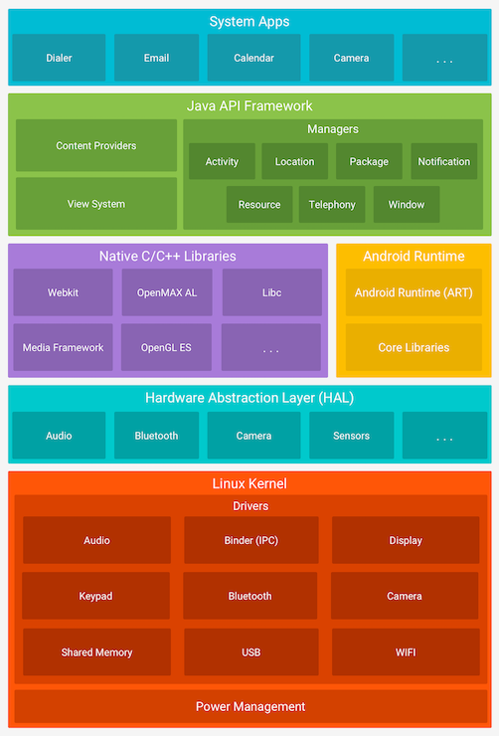
Android Platform Overview
Android architecture: Android's software stack is composed of several different layers. Each layer defines interfaces and offers specific services.

Slide 9
Android architecture contd...
Linux Kernel: At the lowest level, Android is based on a variation of the Linux Kernel containing some significant additions, including Low Memory Killer wake locks, the Binder IPC.
HAL: On top of the kernel, the Hardware Abstraction Layer (HAL) defines a standard interface for interacting with built-in hardware components.
Runtime Environment: Android apps are written in Java and Kotlin and then compiled to Dalvik bytecode ↗ which can be then executed using a runtime that interprets the bytecode instructions and executes them on the target device.

Slide 10
Android architecture contd...
Android Runtime (ART) : The execution environment for Android applications.
Android Runtime Replaces the older Dalvik Virtual Machine, optimized for better performance.
Core Libraries: Provides fundamental Java libraries for application development.
Java API Framework: Provides APIs for application development and system interactions.
System Apps: Pre-installed apps that provide essential functionalities such as Dialer, Email, Calendar, Camera, etc ... Core applications for user interaction.

Slide 11
Mobile application components
Android apps are made of several high-level components. The main components are:
Activities
services
Broadcast receivers
Content providers
Intents(explicit and implicit)

Slide 12
APK Structure
META-INF <-- Contains metadata about the APK (like signature and certificate).
AndroidManifest.xml | <-- Describes the structure, components, and permissions of the app.
res/ <-- Contains resources such as images, layouts, and strings.
assets/ <-- Contains raw assets bundled with the APK (e.g., fonts, databases).
lib/ <-- Contains native libraries (e.g., .so files) used by the app.
classes.dex | <-- Contains the compiled bytecode (DEX) of the app.
resources.arsc | <-- Contains precompiled resources for quicker access during runtime

Slide 13
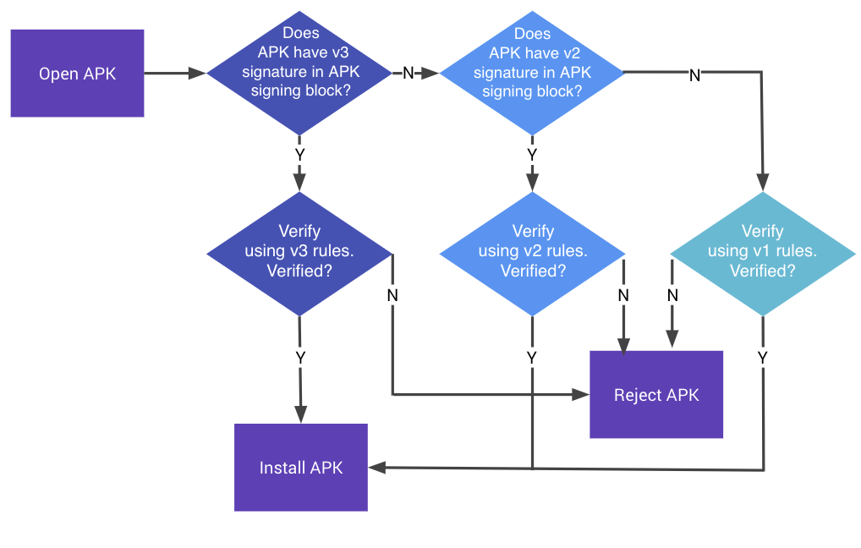
APK signing schemes

Slide 14
Sandboxing and permissions
Application Sandboxing: isolation of apps from each other and the OS using the Linux user ID (UID) and filesystem permissions. Each app runs in its own sandboxed(isolated) environment.
UID: Each Android app is assigned a unique UID (User ID) when installed. This UID is used to distinguish each app's data and resources
SELinux: enforces mandtory access control policies at runtime.
filesys isolation: app data is stored in data/data/package and only accessible to that app only.
permissions: app must declare permissions to access other data or hardware.

Slide 15
Permissions
Because Android applications are sandboxed, they can access only their own files and any world-accessible resources on the device. Such a limited application wouldn’t be very interesting though, and Android can grant additional, fine-grained access rights to applications in order to allow for richer functionality
Applications request permissions by adding one or more <uses-permission>tags to their AndroidManifest.xml file and can define new permissions with the <permission> tag

Slide 16
Permission Protection Levels
normal: defualt value and automatically granted without requiring user confirmation.
dangerous: These permissions allow access to sensitive data or system resources. Because they could affect user privacy or security, Android requires the user to explicitly grant or deny these permissions at runtime
Signature: granted only to apps that are signed with the same certificate
SignatureOrSystem: granted to apps that are either signed with the same certificate or are system apps.

Slide 17
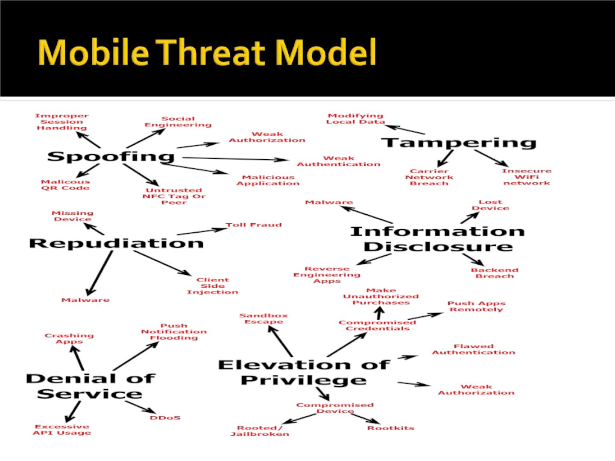
Mobile Application Threat Model

Slide 18
Deeplinks and webviews
A deep link: is a type of URL that links directly to specific content or functionality within a mobile app, rather than just launching the app’s home screen.
Common Vulnerabilities in Deep Links
Authentication bypass
Unvalidated input (leading to XSS or data manipulation)
Sensitive actions performed without user confirmation
Exposing internal activities via exported components

Slide 19
webviews
A WebView is a component (android.webkit.WebView) used to load and display web pages inside an app.
Key Areas to look in WebViews
webView.getSettings().setJavaScriptEnabled(true)
webView.addJavascriptInterface(new MyObject(), "Android")
webView.getSettings().setAllowFileAccess(true)
webView.getSettings().setAllowContentAccess(true)
webView.getSettings().setAllowFileAccessFromFileURLs(true)
webView.getSettings().setAllowUniversalAccessFromFileURLs(true)
webView.getSettings().setDomStorageEnabled(true)
webView.getSettings().setDatabaseEnabled(true)
webView.getSettings().setAppCacheEnabled(true)
webView.getSettings().setMixedContentMode(...)
WebView.setWebContentsDebuggingEnabled(true)

Slide 20
owspTop 10 Mobile Risks ( 2024)
1. Improper Credential Usage
2. Inadequate Supply Chain Security
3. Insecure Authentication/Authorization
4. Insufficient Input/Output Validation
5. Insecure Communication
6. Inadequate Privacy Controls
7. Insufficient Binary Protections
8. Security Misconfiguration
9. Insecure Data Storage
10. Insufficient Cryptography

Slide 21
Mobile App Tampering and Reverse Engineering
Reverse engineering is the process of analyzing an application to extract information about its design, architecture, code, and behavior without access to its source code.
Identify hardcoded secrets (API keys, credentials)
Detect insecure coding practices
Understand app logic (especially for authentication, encryption, etc.)
Analyze third-party libraries and SDKs used
Reveal hidden or undocumented features
Tools: jadx, apktool, hopper, ghidra ...etc

Slide 22
Mobile Binary Tampering
Mobile Binary Tampering refers to the unauthorized modification of a mobile application's binary (APK/IPA) to change its behavior, bypass protections, or inject malicious code.
Common Use Cases of Tampering
Bypassing login/PIN/root/jailbreak checks
Disabling SSL pinning
Unlocking paid features
Injecting malicious code or payloads

Slide 23
How to tamper an apk file
Decompile APK using JADX or apktool
Locate sensitive logic: e.g., if (isRooted()) { exitApp(); }
Modify smali or Java code (depending on decompile method)
Rebuild APK with apktool
Re-sign APK using jarsigner or apksigner

Slide 24
Mobile Application Security Testing
Principles of Testing:
Black-box testing: is conducted without the tester’s having any information about the app being tested.
White-box testing: (sometimes called “full knowledge testing”) is the total opposite of black-box testing in the sense that the tester has full knowledge of the app.
Gray-box testing: is all testing that falls in between the two aforementioned testing types: some information is provided to the tester (usually credentials only), and other information is intended to be discovered

Slide 25
Mobile Application Security Testing Methodology
Information Gathering: Gather basic details about the mobile app to understand its functionality and identify potential security risks.
Static Analysis (Code Review): Analyze the app’s source code (or decompiled code) to identify vulnerabilities.
Dynamic Analysis: Monitor how the app behaves during execution to detect runtime vulnerabilities and interaction with external resources.

Slide 26
Static analysis of mobile application
A method of analyzing mobile applications without executing them.
Examines the app’s source code, binaries, and configurations for potential vulnerabilities.
Helps identify security flaws early in the development process.
Reduces risk by preventing known vulnerabilities in the app.
Tools for static analysis
APKTool, JADX, Mobsf, busybox, QARK , AndroBugs ...etc
Process of Static Analysis
Obtain the APK/IPA file or source code.
Decompile or disassemble the app.
Analyze the app’s codebase, configuration files, and dependencies etc.

Slide 27
Things to look in static analysis
Misconfigured AndroidManifest.xml (Exported components, insecure permissions, deeplinks, intents, backups, debugable,cleartext trafic, )
Improper use of Intent (Implicit intents leading to data leaks)
Insecure file permissions (MODE_WORLD_READABLE or WRITABLE)
Use of deprecated algorithms (MD5, SHA1, ECB,DES,Random,CBC etc...)
Weak key generation or hardcoded encryption keys
Insecure Logging, Backdors left in the code
Hardcoded secrets (API keys, passwords, tokens)
Sensitive data stored in plaintext (SharedPreferences, SQLite, )
Insecure SDKs
Lack of Code Obfuscation (Easy decompilation via JADX, Ghidra)...and many more...

Slide 28
Dynamic analysis of mobile application
Dynamic analysis refers to the process of analyzing a mobile application while it is running, often in a real or simulated environment
Identify runtime vulnerabilities and avoiding false positives
Detect vulnerabilities that static analysis may not reveal.
Assess how an app behaves in a real-world scenario.
Identify Exploitable Vulnerabilities: Discover vulnerabilities such as memory corruption, improper authentication, insecure data storage, and API issues.
Focuses on the app's behavior while it's running (runtime analysis, API communication, and real-world interaction.

Slide 29
Tools for Dynamic Analysis
Frida
Genymotion
Burp Suite and owasp zap
Objection
Drozer
MobSF(Mobile Security Framework)
Wireshark
ADB and many more ........

Slide 30
Methodology
Set up a testing environment (emulator or physical device).
Install and configure analysis tools (e.g., Burp Suite, Frida).
Intercept network traffic and analyze API interactions.
Monitor the app’s behavior (e.g., authentication, data handling).
Manipulate app runtime behavior (e.g., bypassing SSL pinning or root detection).
Sensitive information like credit card details or user data being stored or transmitted in plaintext.
Weak or no encryption during API calls or external communication.
Authentication & Session Management
Unprotected deep links or exported components and etc.......

Slide 31
Intercepting Android Traffic via burp suite
Intercepting Android traffic refers to the process of capturing and analyzing the data exchanged between an Android mobile application and remote servers. This is a critical step in mobile application security testing, allowing security professionals to uncover.
A Man-in-the-Middle (MITM) attack is a technique where an attacker secretly intercepts, alters, or relays communication between two endpoints—in this case, the mobile app and the server.

Slide 32
Configuring an Android device to work with Burp Suite
Step 1: Configure a dedicated proxy listener in Burp
In Burp, open the Settings dialog.
Go to Tools > Proxy.
Under Proxy Listeners, click Add.
On the Binding tab, set Bind to port to any available port.
Set Bind to address to All interfaces.
Click OK and confirm your entries when prompted.

Slide 33
Step 2: Configure your device to proxy traffic through Burp
On your Android device, go to the network and internet settings.
Open the network details for the Wi-Fi network that you want to use for testing.
Enter edit mode.
In the advanced settings, choose the option to configure a proxy manually.
Set the Proxy hostname to the IP address of the machine you're using to run Burp.
Set the Proxy port to the port you assigned to the new proxy listener you configured in Burp. For more information, see Configure a dedicated proxy listener in Burp
Save your changes and then connect to the Wi-Fi network. Your device's web traffic is now proxied through Burp.

Slide 34
Step 3: Add Burp's CA certificate to your device's trust store
In Burp, open the Settings dialog.
Go to Tools > Proxy.
Under Proxy Listeners, click Import / export CA certificate.
In CA Certificate dialog, select Export > Certificate in DER format and click Next.
Enter a filename and location for the certificate. Note that you need to explicitly include the .der file extension.
Click Next. The dialog indicates that the certificate was successfully exported.
Add the certificate to your device's trust store

Slide 35
Step 4: Test the configuration
To make sure that you've completed the configuration successfully and are ready to start testing:
In Burp, go to the Proxy > Intercept tab.
Use the button to turn the Intercept feature on.
On your Android device, open the browser.
Browse to any site using HTTPS. If you've completed the configuration successfully, the page should load without any security warnings and you should see your traffic in Burp on the Proxy > HTTP history tab.

